Slide 1
Job Title Hierarchy Classification
Kyle Hubbard
May 13, 2015

Slide 2
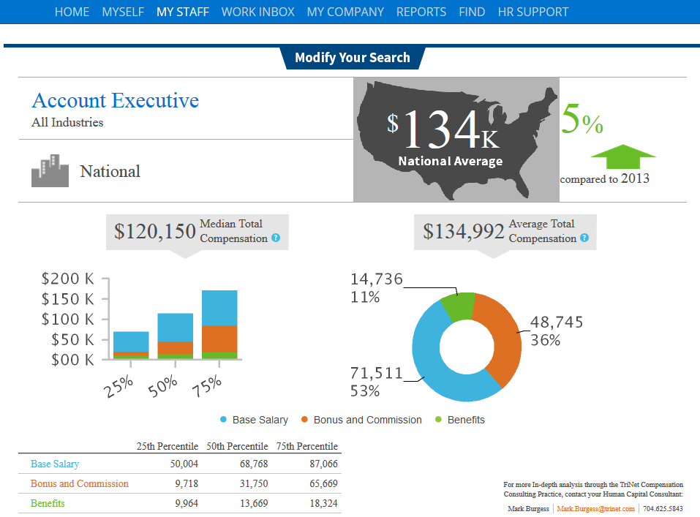
Motivation:
Improve Compensation Report

Slide 3
Compensation Report Improvements
Increase available job title and geographic coverage
  Job title clustering
Expand features
  Create job Hierarchy
  Provide job descriptions

Slide 4
How to increase job titles and geographic coverage?
In order to increase our geographic coverage and available job titles we need more data
  Job title clustering
  Combine related job titles to form uniform job titles
    Account Executive:
      Account Executive Midwest
      Account Executive Inside Sales
      Account Executive Outside Sales
      Major Account Executive

Slide 5
How to expand features?
Include Job title hierarchy and job description
  Where does a job title fit into the Standard Occupational Classification (SOC) System?
    Major groups: 23
      Minor group: 97
        Broad group: 461
          Detailed group: 840+
            Job Descriptions
Notes:
Structure the problem more

Slide 6
Sample Hierarchy
Sales and
Related Occupations
Sales Representatives
Services
Advertising Sales
Agents
Insurance Sales
Agents
Major Group
Minor Group
Broad Group
Detailed Occupation
Insurance
Agent
Advertising
Executive
Job Description
Sell life, property, casualty, health, automotive …
Sell or solicit advertising space, time, or media in …
Supervisors of Sales Workers
Retail Sales Workers

Slide 7
Data Sources
Bureau of Labor Statistics
  Hierarchy
Career builder
  Job Descriptions
  SOC hierarchy applied to job titles
TriNet internal data
  Job titles, salary , demographics

Slide 8
Project Pipeline
Data Collection
Text Processing
Outlier Detection
Feature Selection
Modeling

Slide 9
Data Collection
TriNet job titles used for key word searches on career builder API
  Collected approximately 120,000 job titles and descriptions
BLS data available for download on their website

Slide 10
Data Collection
Search Keyword: Account Executive
Job Title | Description Teaser | Pay | Education Required | Skills | Major Group Code | Major Group Description | Broad Group | Broad Group Description
Account Executive - Central Region | Central Account Executive will be fully supported by management, operations, and marketing before, during ... | N/A | Associate Degree | Sales managementBusiness developmentCustomer RelationshipCommunicationSalesforce.comProblem SolvingVideoconferencingSales processSales TrainingInnovationCustomer relationship management | 41 | Sales and Related | 41-3099.00 | Sales Reps (Services)
Sales Account Executive | Sales Account Executive About our company: The International Council of E-Commerce Consultants ... Sales Account Executive Desired Skills and... | $50k/year | Associate Degree | Business developmentMicrosoft ExcelBusiness To BusinessCommunicationProblem SolvingMicrosoft OutlookPublic speakingSales processSales TrainingElectronic commerceSolution SalesNeeds Based Selling | 41 | Sales and Related | 41-4011.00 | Sales Reps (Technical and Scientific Products)
Commercial Account Executive | The Commercial Account Executive is critical to this Houston teamâ€™s retention and onboarding ... Commercial Account ExecutiveÂ Requirements At least 5... | $80k - $90k/year | Not Specified | CommunicationCross-sellingAccount ManagementClient Service | 41 | Sales and Related | 41-3021.00 | Insurance Sales Agents

Slide 11
Text Processing
Make all the words in the text as uniform as possible
  Lowercase
  Numeric, Punctuation and Special Character removal
  Stopword removal
  Geography removal
  Spellcheck
  Keep unique words

Slide 12
Outlier Detection
Duplicate Removal
Salary cleaning and outlier elimination

Slide 13
Feature Selection
Available features:
  Geography
  Company
  Education
  Employment Type
  Skills
  Salary Range
  SOC codes
  Job Titles
  Job Description

Slide 14
Feature Selection
Available features:
  Geography
  Company
  Education
  Employment Type
  Skills
  Salary Range - normalized
  Job Titles
  Job Description
  SOC codes and Descriptions

Slide 15
Feature Variations
Job Description Teaser
  ~ 50,000 obs and 175 broad group classifiers
    Class label: Sales Reps Services
    Job title: Account Coordinator
    Job description teaser: account coordinator salary annually qualifications experience management
Notes:
Show an example of what the data looks like

Slide 16
Feature Variations
  Job Description Teaser + Double weighted Job Title
    ~ 50,000 obs and 175 broad group classifiers
    Class label: Sales Reps Services
    Job title: Account Coordinator
    Job description teaser: account coordinator account coordinator account coordinator salary annually qualifications experience management

Slide 17
Feature Variations
Job Description Teaser + Double Weighted Job Title + Salary
  ~ 9,700 observations and 100 broad group classifiers
    Class label: Sales Reps Services
    Job title: Account Coordinator
    Job description teaser: account coordinator account coordinator account coordinator salary annually qualifications experience management
    Normalized Salary: Range[0,1]

Slide 18
Feature Variations
Two Step Classification: Major group then broad group
  Job Description Teaser + Double Weighted Job Title + Salary
    ~ 9,700 observations and 100 broad group classifiers
  Major group: 23 Class Labels
  Broad Group: 100 broad group classifiers
    Major group class label: Sales and Related
    Broad group class label: Sales Reps Services
    Job title: Account Coordinator
    Job description teaser: account coordinator account coordinator account coordinator salary annually qualifications experience management
    Normalized Salary: Range[0,1]

Slide 19
Classification Methods
SVM
  Broad Group
    Linear, RBF, Poly, Sigmoid
    Transformations: TF-IDF, Token Counts
Naïve Bayes
  Broad Group
    Transformations: TF-IDF, Token Counts
  Two Step: Major Group => Broad Group
    Transformations: TF-IDF, Token Counts
Notes:
Add something to illustrate the modeling

Slide 20
Results

Slide 21
Two Step Results: Major Group

Slide 22
Two Step Results: Broad Group

Slide 23
Next Steps
Continue to work on job title clustering
Collect more data
Explore other models and features

Slide 24
Thanks!
Rob
Matt
Ankit
Chetan
General Assembly

